Slide 1
TASK 2
BIRUNGI JEANRITAH ROENAH

Slide 2
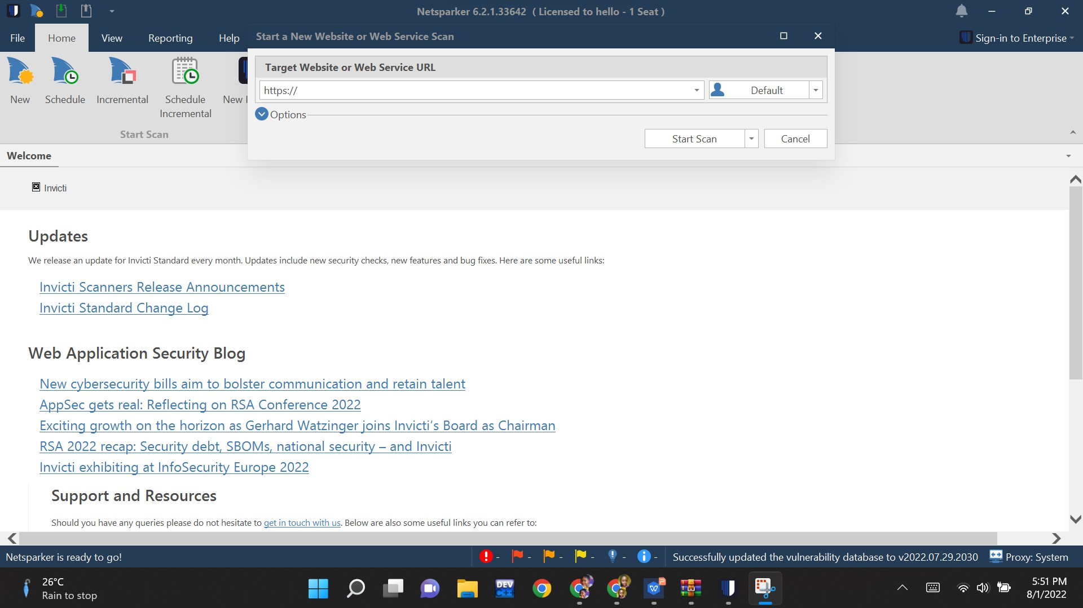

Slide 3
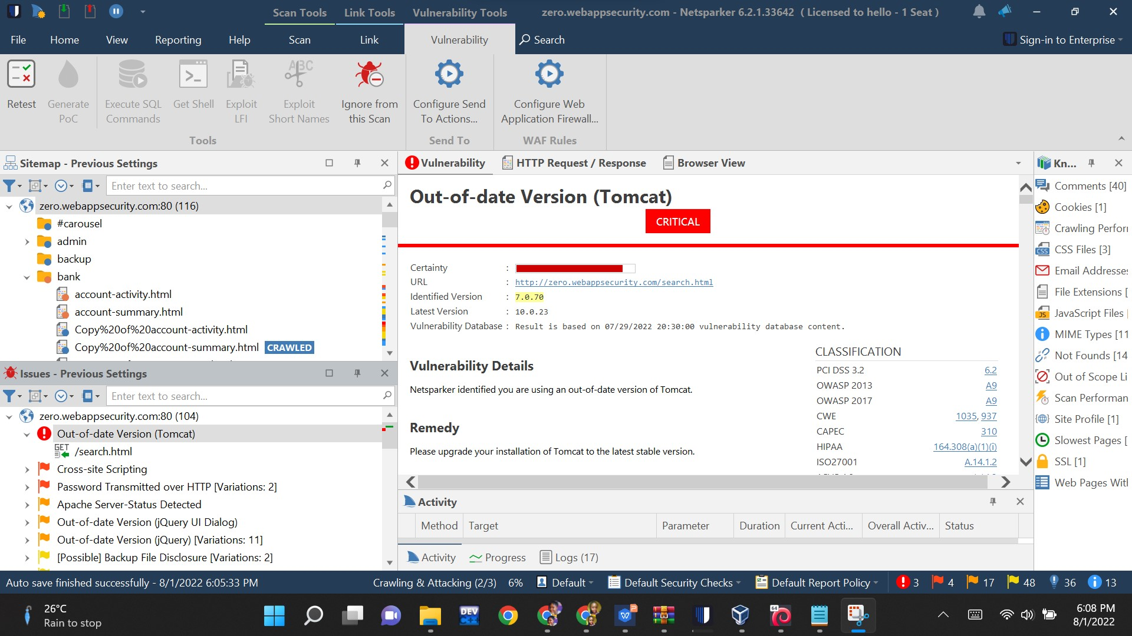

Slide 4
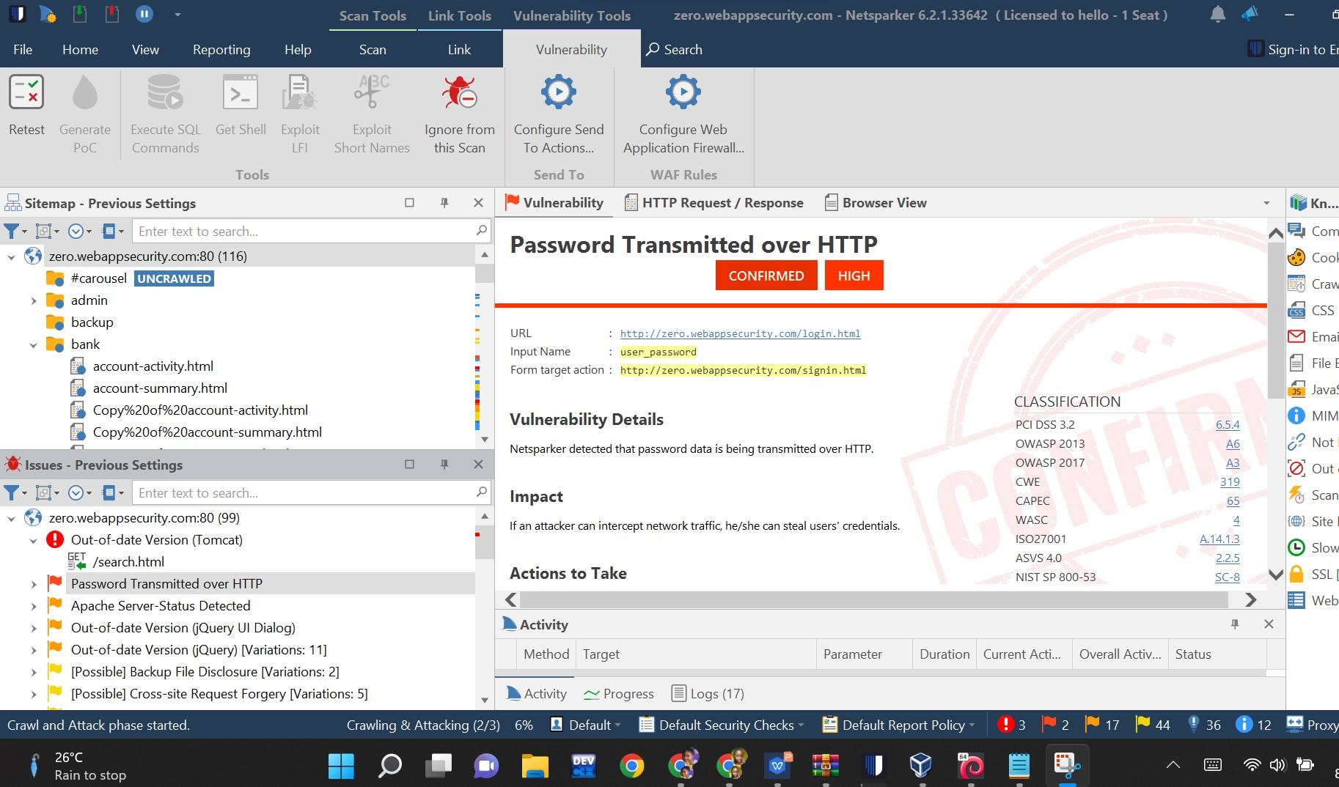

Slide 5
